Slide 1
Modules and Scripting
Overview
In this lesson, students will discover how to import and use libraries to enhance their programs. They will also learn how to read documentation of new libraries.
Duration 120 minutes
Learning Objectives
In this lesson, students will:
Understand how libraries, packages, and modules relate to one another.
Use import statements to access Python libraries.
Use Python scripts to automate tasks.
Create Python scripts to read and write to files.

Slide 2
Pre-Class Materials and Preparation
For remote classrooms: Virtual breakout rooms and Slack may be needed to facilitate the partner exercise and discussions. As you plan for your lesson:
Consider how you’ll create pairs for the partner exercise (randomly, or with pre-assigned partners).
Determine how (if at all) exercise timing may need to be adjusted.
For helpful tips, keep an eye out for the For remote classrooms tag in the speaker notes.
Prepare screenshots and answers to exercises in advance so that they can be easily shared in Slack during your lecture.

Slide 3
Suggested Agenda
Time | Activity
0:00–0:50 | Welcome + Modules
0:50–1:00 | Break
1:00–1:50 | Scripting
1:50–2:00 | Wrapping Up, Q&A, and Exit Ticket Completion

Slide 4
Jupyter Notebook
The exercises referenced in this lesson can be found in the Python Workbooks + Data folder.

Slide 5
Modules and Scripting

Slide 6
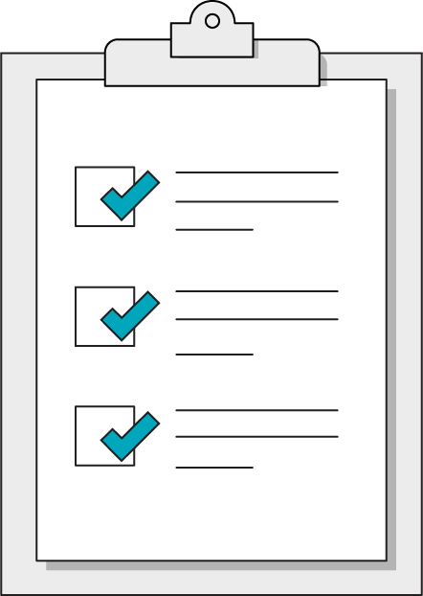
Today’s Learning Objectives
In this lesson, you will:
Understand how libraries, packages, and modules relate to one another.
Use import statements to access Python libraries.
Use Python scripts to automate tasks.
Create Python scripts to read and write to files.
6 | © 2020 General Assembly
Notes:
Purpose: Set expectations for the lesson.
For remote classrooms:
Capture a screenshot of this slide and drop it in the class Slack channel.

Slide 7
Modules
Modules and Scripting
Notes:
Duration: 50 minutes

Slide 8
A Little Help From Our Friends
Modules are collections of helpful Python code and functions we can use. Instead of reinventing the wheel, modules provide us with immediate benefits:
Reliable, heavily tested code.
Well-known patterns for easy collaboration.
The ability to focus on your application’s higher-level needs.
Notes:
Purpose: Define modules.
TALKING POINTS:
You will encounter numerous modules that others have written.
They are free to use, and you can think of them as extensions of Python's functionality.

Slide 9
Importing from the Standard Library
Some modules are so commonly used that they are bundled with Python itself.
To get a feel for modules, let’s explore the random module. In order to use a module, we first have to import it by including an import statement at the top of our code:
import random
# Now, we can use the random module and its methods, such as randint.
random_die_roll = random.randint(1,6)
Notes:
Purpose: Explain how to import modules.
TALKING POINTS:
Other modules may need to be separately downloaded; we'll get to this later.
The Python Standard Library will never need to be downloaded separately, it’s always just an import statement away.

Slide 10

Read the Docs
The downside of borrowing someone else's code is having no idea how to use it — at first, that is!
Python’s Standard Documentation provides a good place to begin reading up on the random module. Other modules may have different documentation sources.
Notes:
Purpose: Emphasize the importance of documentation for modules.

Slide 11

6.1 Games of Chance
20 minutes
Let’s explore the random module using some challenges involving random chance. Read the documentation to discover helpful methods for each task.
Notes:
Purpose: Allow students to practice working with modules.
TEACHING TIPS:
Given the documentation, there should be different answers from different students on each task. Compare/contrast some options before moving on.

Slide 12
Library Hierarchy
Libraries are large collections of tools that will prove very helpful to you.
These libraries are often organized into one or more packages.
Packages can be organized further into one or more modules.
Library
Package 1
Package 2
Module 1A
Module 2A
Module 2B
Notes:
Purpose: Show how packages and modules fit together.

Slide 13
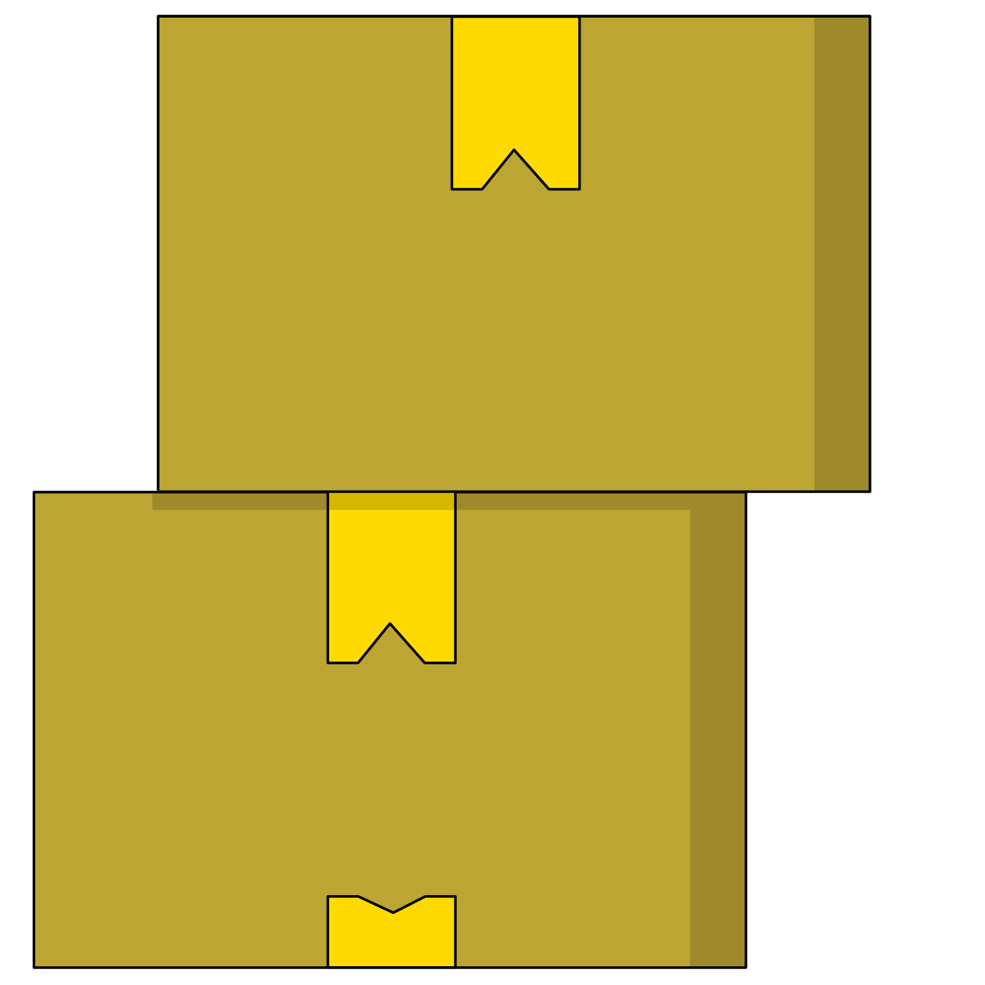
Package Delivery
Libraries, packages, and modules need to be installed in order to use these tools on your computer:
%pip install library_name
If you want to import only one module from a package:
from package_name import module
Notes:
Purpose: Demonstrate how to work with packages.
TALKING POINTS:
The “%” sign tells Anaconda/Jupyter to run the line as a shell command.
Python package installation can be tricky outside of this context, so hopefully a simple pip install in Jupyter Notebook will do the trick.
Sometimes, a package contains just one module, which is OK. This may seem strange, but will become more familiar over time.

Slide 14

6.2 Geocoder Road Trip
20 minutes
Install and use the “geocoder” library for the challenges in Section 6.2.
Notes:
Purpose: Give students an opportunity to work with packages.
TEACHING TIPS:
The purpose of this activity is to allow students to:
A. Understand how easily accessible new libraries are.
B. Practice reading documentation given one clear direction.
C. Reinforce basic logic skills in Python by using lists and conditionals.

Slide 15
Scripting
Modules and Scripting
Notes:
Duration: 50 minutes

Slide 16

Putting It All Together
Armed with the foundational building blocks of Python, we can start creating genuinely useful scripts to automate specific tasks, like:
Filing analysis.
Sending reporting emails.
Formatting files.
Processing data.
Notes:
Purpose: Discuss scripts’ capabilities.

Slide 17
What’s a Script?
When people refer to scripts, they usually mean code that:
Takes input.
Gives output.
Reads or writes to a file.
Performs a task.
We have “Performs a task” down! Let’s look at how we can build useful tools in Python by combining these other layers in our programs.
Notes:
Purpose: Define scripts.
TALKING POINTS:
One of the strongest use cases for Python is writing helpful scripts to automate work tasks or create helpful tools for yourself.
Scripting will open up our ability to interact with files and provide meaningful input to our Python code; in other words, to start building useful things!

Slide 18
Input From Users and Files
User Input
File Input
Prompt users to type in a response to given text, then process that response as a variable.
name = input("Type your name")
# the script pauses to wait
# continues when user submits
print(name)
Access the contents of a specific file from within a Python script.
log = open("./log.txt", "w")
# opens log.txt in 'write' mode
log.write("Another great day!")
# writes to the end of the file
log.close()
Notes:
Purpose: Explain the basic functions of scripts.

Slide 19
Open for Business
When accessing files, you need to specify the “mode” in which the file should be opened.
You must also be sure to close the file after working with it. Use the following pattern to let Python do that for you automatically:
with open("log.txt", "a") as log:
log.write("All clear.")
 | Mode
'r' | Read-only mode.
'w' | Write.
'a' | Append new contents to the end of the file.
'+' | Add to any mode to include read and write.
Notes:
Purpose: Explain how to manipulate files with python scripts.

Slide 20

6.3 So Much to Do...
10 minutes
Add a comment to each line of the “to-do list” script in Section 6.3 of the notebook.
Notes:
Purpose: Give students a chance to write scripts.

Slide 21

With These Powers Combined...
Managing files manually can get a bit awkward. Fortunately, there are plenty of modules out there to make things easier — especially for common file and data formats like .csv!
Let’s explore a basic module called “csv” for just this purpose.
Notes:
Purpose: Connect the earlier part of the lesson (modules) with scripting.

Slide 22
What Are Spreadsheets Made Of?
Before we start manipulating .csv files in Python, let’s reflect:
What Python data structure might be best for storing a .csv row ID and the data in the corresponding row in the .csv file?
A dictionary is best, because it is a set of key (row ID) and value (the data corresponding to that row) pairs.
Notes:
Purpose: Help students connect Python basics with scripting.

Slide 23
What Are Spreadsheets Made Of? (Cont.)
Before we start manipulating .csv files in Python, let’s reflect:
What Python data structures might be best for representing a whole table of rows?
A list of dictionaries, because a list preserves the order of the rows.
Notes:
Purpose: Help students connect Python basics with scripting.

Slide 24
Reading and Writing
Let’s explore how we would read and write to a .csv file by consulting the documentation for the csv library. Consider:
How can we read a row from a .csv file?
How can we write a new row to an existing .csv file?
How can we modify the existing rows of a .csv file?
Notes:
Purpose: Give students the opportunity to explore documentation.
TEACHING TIPS:
Allow students to jump into the docs for a few minutes before you solicit answers and highlight relevant examples for each question.
Stress that an important part of using libraries is learning to read their documentation.

Slide 25

6.4 TPS Reports
20 minutes
Let's translate a given list of dictionaries into a .csv file using the csv module.
Notes:
Purpose: Have students practice using the csv module.

Slide 26
Automating With Python
One of the main uses of Python as a productivity tool is creating reusable scripts to analyze and generate .csv files.
What regularly scheduled processes can you anticipate creating a Python analysis script for, either for your own role or to enhance the productivity of another team member?
Notes:
Purpose: Help students connect what they learned in class to their regular workflow.

Slide 27

6.5 Ultimate RPS Challenge
20 minutes
As a bonus challenge, let’s use our .csv-writing abilities to keep track of all of the games played from a command line version of Rock, Paper, Scissors.
Notes:
Purpose: Give students additional practice working with the csv module.
TEACHING TIPS:
If students are not be able to finish this exercise in the given class time, encourage them to complete it as homework.

Slide 28
Wrapping Up
Modules and Scripting
Notes:
Duration: 10 minutes

Slide 29
Recap
Looking Ahead
In today’s class, we…
Discussed how libraries, packages, and modules relate to one another.
Used import statements to access Python libraries.
Used Python scripts to automate tasks.
Created Python scripts to read and write to files.
On your own:
Work through the Python progress assessment on myGA (due at the end of the unit).
Start thinking about capstone project ideas!
Next Class:
APIs
Notes:
Purpose: Recap what was covered in the lesson.

Slide 30

Don’t Forget: Exit Tickets!

